Slide 1
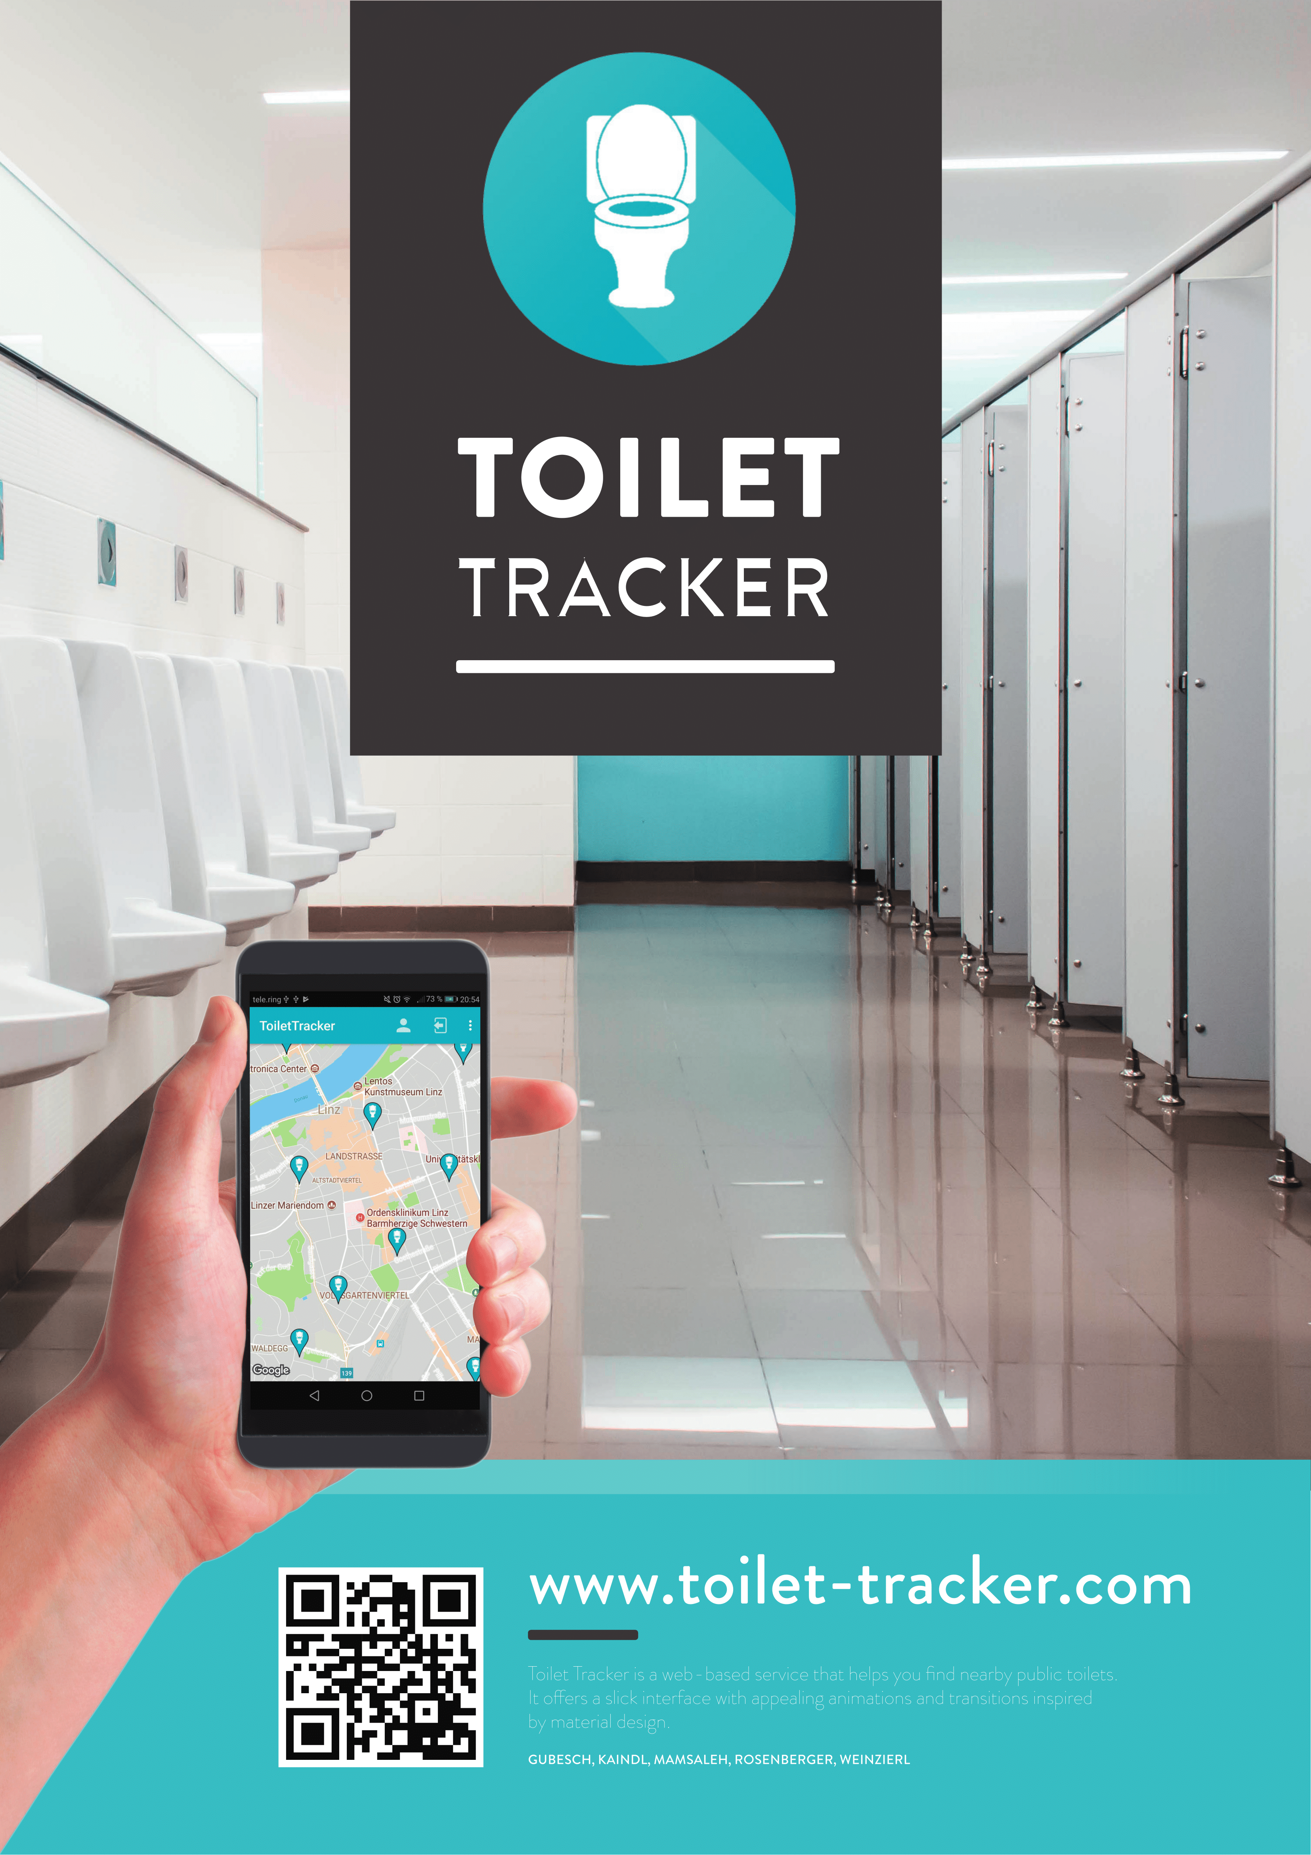

Slide 2

Gliederung
01
Team
02
Timeline
03
Toilet Tracker
04
Demo

Slide 3


Team

Slide 4





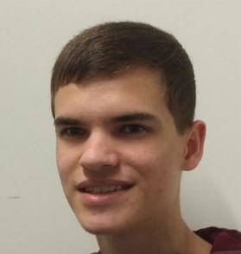


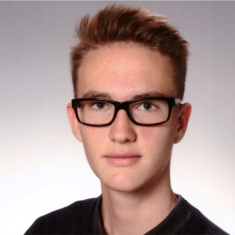
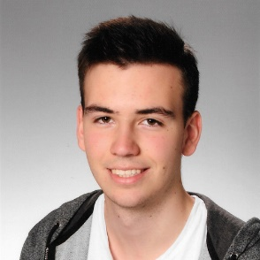
Unser Team
Gubesch
Kaindl
Mamsaleh
Rosenberger
Weinzierl
Testing
Documents
Web Client
Database
Documents
Mobile Client
Documents
Projektleiter
Documents
API
Documents
Content

Slide 5
Timeline

Slide 6


Time Line
First Sprint
Second Sprint
First Release
Project Proposal
System Specification
8. Oktober
2017
24. Dezember
2017
22. Jänner
2018
5. März
2018
9. April 2018

Slide 7
Toilet Tracker

Slide 8




Toilet Tracker
Global Usability
You can use our App every- where you want!
Rate Toilets
Tell us what you liked about the place!
Toilet
Tracker
Easy to Use
Simple user interface.

Slide 9
Demo

